Slide 1
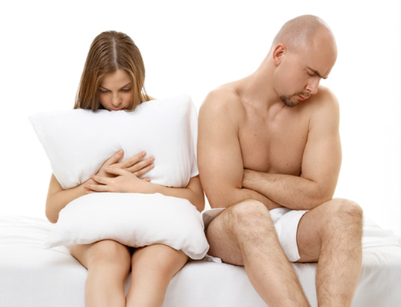
CHAPTER 12
Sexual Difficulties, Dysfunctions, and Treatments

Slide 2
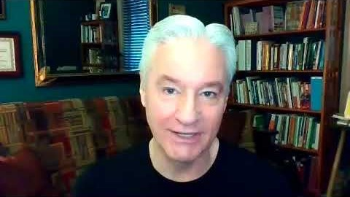

Slide 3


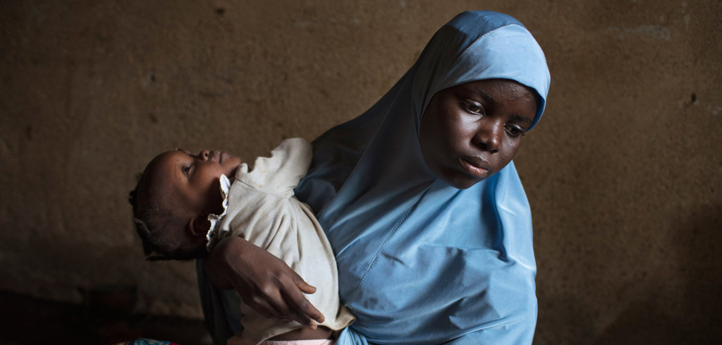
How Common are Sexual Disorders Overall?
Fairly prevalent in most countries.
Multinational studies on sexual dysfunction suggest:
  Sexual dysfunctions are highly variable depending on the specific characteristics of a sample.
  Slight difference in survey design or describing medical terms results in people responding differently.

Slide 4


The Role of Culture in Sexual Expectations
Culture contributes to perceptions:
  About normative sexual functioning and pleasure.
  Of inadequacy in functioning that is within the normative range for people.
Cultural sex roles that:
  Permit equality of experience in both sexes encourage open dialogue about sexual issues and incompatibility.
  Have clearly different expectations for the sexes may:
    Encourage women to be less assertive or aggressive about sexuality.
    Create expectations for men that they are failing if they cannot perform.

Slide 5
The Role of Culture in Sexual Expectations
Sexual scripts in mainstream media may give a false impression about sexual behaviors.
There are also cultural (national) differences in how frequently postnatal physiotherapy is used to restore pelvic floor muscle function after childbirth.

Slide 6
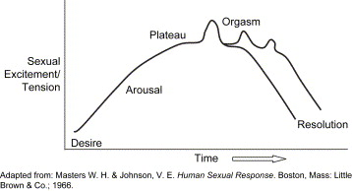
Masters and Johnson Model
Appetitive phase:
  Marks the beginning of sexual interest.
  Involves thought and desire.
Arousal phase:
  Male: blood flow to the penis and erection.
  Female: blood flow to the labia and clitoris, and vaginal lubrication.
Plateau phase: maximum arousal prior to orgasm.
Orgasm: involves an additional peak in physiological arousal:
  Accompanied by ejaculation in the male and vaginal contractions in the female.
Refractory period: decline in physiological arousal after sexual activity:
  Males: period following orgasm during which additional orgasm is not
  possible.

Slide 7
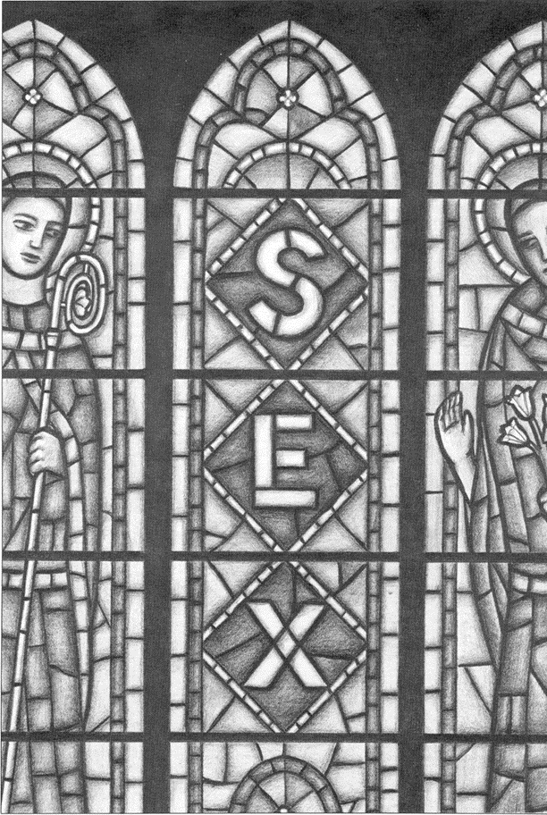
Beliefs, Personal Values, and Self-Concept
Religious beliefs and personal values can affect sexual functioning:
  May contribute to feelings of guilt and shame around sexuality, thoughts, and behavior.
Self-concept and comfort with one’s body is important in sexual functioning.

Slide 8


Relationships and Alignment with Partners
Alignment of values and belief within a relationship impacts sexual functioning.
Issue of alignment may include:
  Negative views of sex that lead to poor reaction to a partner’s sexual interests or needs.
  Individuals may differ in interests, as well as in terms of physiological profiles.

Slide 9
Disorders of Sexual Functioning
Identified in the Diagnostic and Statistical Manual of Mental Disorders, Fifth Edition (DSM-5):
  Marked distress or interpersonal difficulty is a requirement for diagnosis.
  Emphasizes the importance of the subjective experience of the individual and any partner(s) in sexual dysfunction.
Ones here follow DSM-IV-TR; DSM-5 is largely similar.
Etiology: refers to the causes of a disorder.

Slide 10
Subtypes and Specifiers of Sexual Dysfunctions
Lifelong subtype: presence of symptoms lifelong.
Acquired subtype: onset of symptoms after an initial period without the disorder.
Specifiers:
  Generalized vs. situational
  Partner factors
  Relationship factors
  Individual vulnerability factors
  Cultural/religious factors
  Medical factors relevant to prognosis, course, or treatment

Slide 11
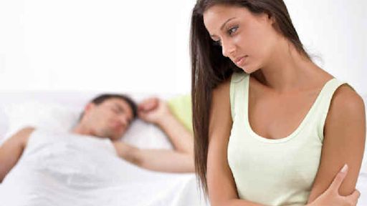
Female Sexual Interest/Arousal Disorder (FSIAD)
Lack of interest in sex:
  Prior to sex, during sex, or both.
Occurs more frequently with age and when a person has a history of illness.

Slide 12

Primary or Lifelong Desire Disorder
Psychosocial causes:
  Guilt, shame, and embarrassment around sexuality.
  History of having been sexually victimized.
Biological causes :
  Hormonal imbalances, particularly low testosterone levels (in both sexes).
  Normal aging or normal variation between individuals.
Asexual individuals:
  Lifelong absence of desire for sex.

Slide 13

Secondary Desire Disorder
Is acquired.
Identified by marked change in sexual interest.
Causes can be associated with specific events:
  Surviving a sexual assault or an illness.
  Reduction in sexual desire for a particular partner.
  Interest in one type of sexual activity but not another.

Slide 14

Disorders of Arousal
Female sexual arousal disorder (FSAD): ongoing difficulty with physiological arousal during sexual activity:
  Inability to attain or maintain adequate lubrication-swelling response of sexual excitement.
Male erectile disorder (ED): difficulty getting or maintaining an adequate erection.

Slide 15
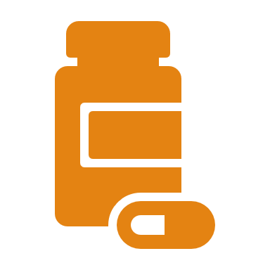
Hormone Replacement Therapy (HRT)
Medical treatment of hypoactive sexual desire disorder (HSDD) with sex hormones such as estrogen, progesterone, or androgen:
  Administered to correct low levels or to increase sexual desire or arousal.
Research indicates:
  Conflicting evidence on the health consequences.
  Transdermal patch may be safer than oral HRT.

Slide 16
Sexual Aversion Disorder
Fear of sex or revulsion to sex:
  Accompanied by avoidance of sex.
  Includes disgust at thought of sex or actual sexual contact.
  May be about all or some particular aspects of sex.
Causes distress or interpersonal difficulty.
Physical symptoms include anxiety or panic attack.
Has similar specifiers as HSDD.
Was not included in DSM-5 due to limited empirical support.

Slide 17

Causes for Sexual Aversion Disorder
Negative values or attitudes about sex.
Predisposition to phobia or obsessive compulsive disorder (OCD).
Traumatic events such as sexual assault.

Slide 18
Treatments for Arousal Disorder
Psychological and behavioral approaches:
  For women, this includes increasing awareness and understanding of what leads to excitement.
Physiological treatment: taking drugs that affect blood flow to the genitalia or hormonal levels:
  Viagra and other PDE- 5 inhibitors.
Mechanical treatment: creating an erection of the penis or clitoris through non-chemical means.

Slide 19
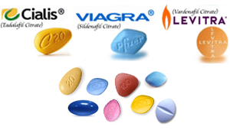
Priapism
An erection that does not subside.
Possible side effect of drugs that treat ED.
Can cause damage to the penis and ultimately death of penile tissue which may require a penectomy.
Treatment:
  Icing the penis
  Draining blood from the penis
  Administering other drugs
Seek medical attention for erections lasting longer than 4 hours!

Slide 20
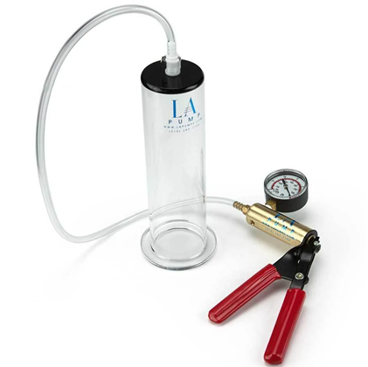
Biological Treatments for Arousal Disorder
Includes drugs that affect prostaglandin:
  Causing blood vessels to dilate.
Administering hormones.
Mechanical treatment:
  Males: penile pump to increase blood flow to the genitalia.
  Females: a small device is placed over the external portion of the clitoris to increase the blood flow.

Slide 21
Premature Ejaculation (PE)
Experiencing orgasm too soon.
Most common sexual dysfunction in males.
Research indicates:
  Younger males with less sexual experience are more likely suffer with PE than older males.
  Clinical criteria: males who ejaculate within 2 minutes.

Slide 22
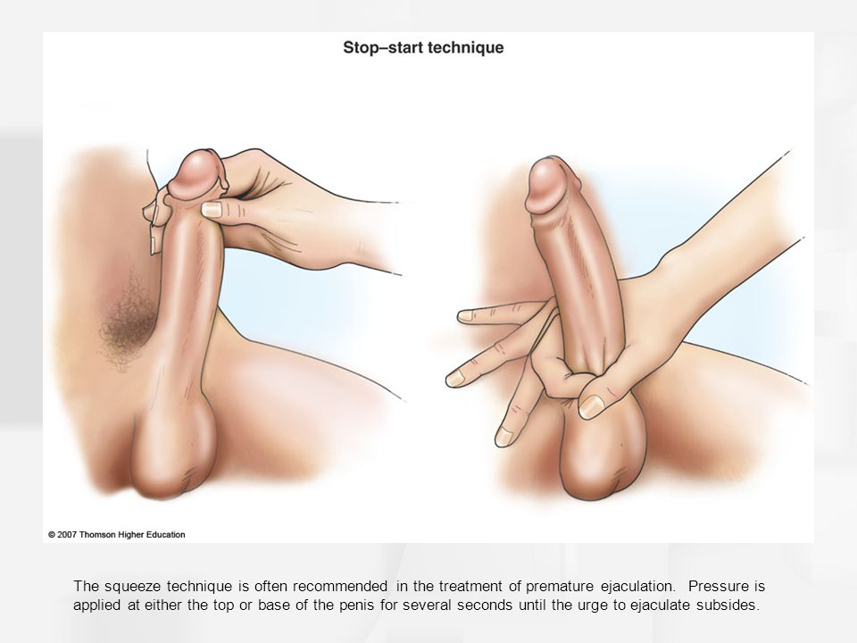
Sex Therapy Techniques to Treat PE
Squeeze technique: placing firm pressure on the frenulum, i.e., the underside of the penis:
  Should be done shortly before ejaculation.
Stop-and-start technique: stopping whatever sexual contact is occurring and waiting until arousal is slightly reduced before resuming.
Require a male to be aware in advance of when he is about to have an orgasm.
Changing positions and more open communication.
Continuing sexual interaction after one or many ejaculations.
Masturbating to orgasm before partnered sex.

Slide 23

Delayed or Absent Orgasm
Male /female orgasmic disorder: inability to experience orgasm.
  Overlaps with arousal disorders in terms of both psychological and biological factors.
  Certain types of medication can make orgasm difficult.

Slide 24
Evolutionary Perspective on Female Orgasm
An accidental byproduct of orgasm having been selected in males.
No recent evolutionary pressure for orgasm in females.

Slide 25
Research Focus
Wallen & Lloyd, 2011:
  Inability to have orgasm in females is a manifestation of individual biological difference in modern humans.
  The ease of a woman experiencing orgasm from penile-vaginal intercourse (PVI) is a function of Clitoral Urethral Meatus Distance (CUMD).
    Shorter distance is associated with easier orgasms.

Slide 26
Treatments for Orgasmic Disorders
Psychotherapy:
  Addresses education and attitudinal factors.
  Emphasizes the importance of open communication in partnered relationships.
Sex therapy: uses technique called sensate focus.

Slide 27
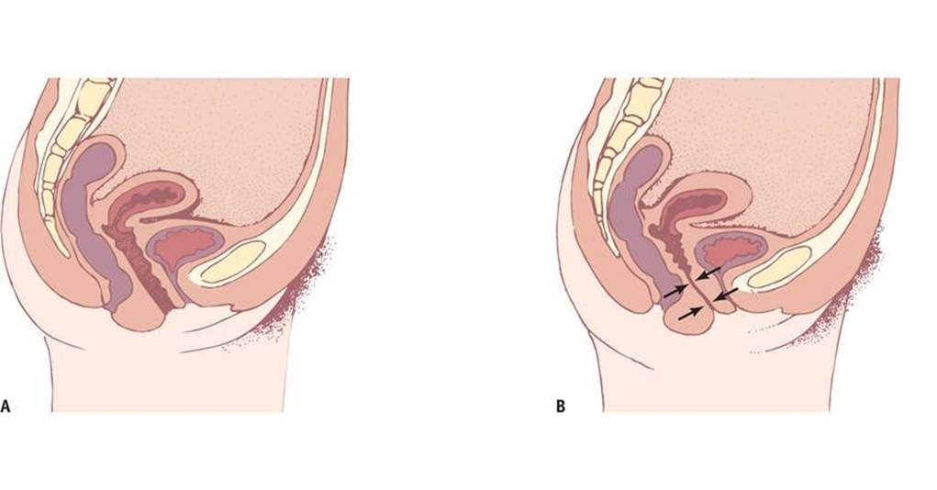
Sexual Pain and Penetration Disorder (GPPPD)
Genito-pelvic pain/penetration disorder (GPPPD): involves problems with:
  Vaginal penetration during intercourse.
  Pain in the vulva or vagina (vulvovaginal pain), or pelvic pain, during vaginal intercourse or penetration attempts.
  Fear or anxiety about such pain before, during, or after vaginal penetration.
  Tensing or tightening of the pelvic floor muscles during attempted vaginal penetration.
  Also called vaginismus.

Slide 28
Sexual Pain Disorders and Treatment
Earlier editions of the DSM separated sexual pain into two disorders:
  Dyspareunia: genital pain associated with sexual intercourse.
  Vaginismus: reflexive muscle spasm of the muscles of the outer third of the vagina during sexual intercourse or other penetrative acts.
Treatment:
  Sex therapy
  Sufficient lubrication
  Practicing relaxation
  Vaginal dilation

Slide 29
Other Causes of Sexual Pain
Thick hymen:
  Surgical procedure necessary to permit comfortable intercourse.
Pain or bleeding during sex (not due to menstruation):
  Indicates infection or other medical problem.
Peyronie’s disease: causes the penis to bend.
  Builds up scar tissue in the connective tissue surrounding the corpora cavernosa.

Slide 30
Pain During Anal Sex
Little research exists on pain during anal sex, and there is no DSM nor ICD diagnosis for this condition.
Anal pain is known as anodyspareunia.
While 30% of women and 7% of men reported pain during vaginal intercourse, of male-female partners who had receptive anal intercourse (female receptive, male penetrative), 72% of the women and 15% of the men reported pain.
Communication, lubrication, and relaxation are needed to reduce discomfort.

Slide 31
Professionals Who Treat Sexual Dysfunction
Medical professionals:
  Approach the treatment of sexual dysfunction from the biological perspective.
Psychotherapists:
  Treat sexual dysfunction with psychotherapy and typically cannot prescribe medicine:
    Psychodynamic and interpersonal therapists
    Cognitive-behavior therapists
    Relationship and couples therapists/counselors
Sex therapists: licensed health practitioners or psychotherapists specialized in treating sexual dysfunction.

Slide 32
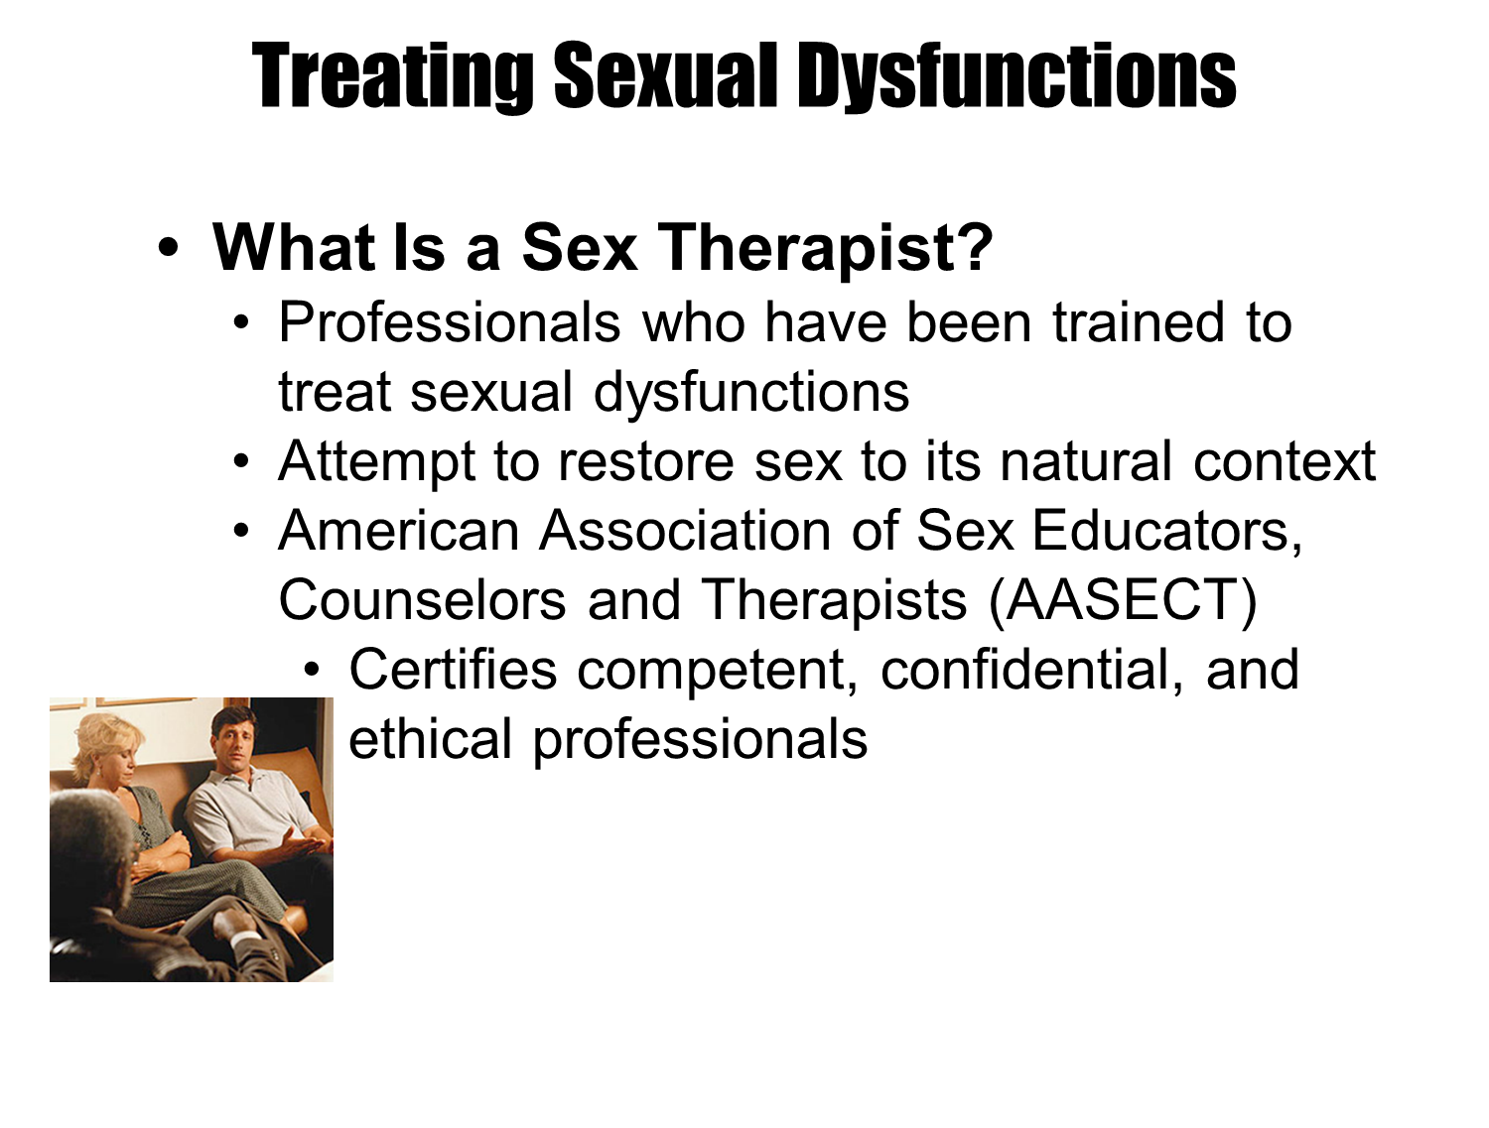
Treating Sexual Dysfunctions

Slide 33
Integrated Sex Therapy
Integrates the biological and psychosocial approach to sex therapy.
Typically requires multiple providers.
Surrogate partners (sex surrogates): individuals who have sex with people to improve their sexual functioning:
  Do not self-identify as sex workers or prostitutes but others may consider them as such.
  Surrogate partner therapy works in conjunction with a sex therapist or psychotherapist.

Slide 34


Awareness, Attitudes, and Lifestyle
Cultural sensitivity is important in sex therapy:
  Cultural and religious traditions are an important part of a person’s self.
Education about normal variations in sexual response create a more positive feeling about addressing the dysfunction.
Health, diet, and fitness may also exacerbate or cause sexual dysfunctions.

Slide 35
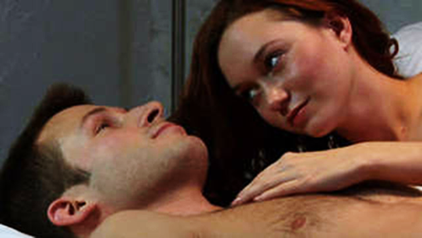
Communication and Relationships
Effective sex therapy requires:
  Communicating directly about sexual needs.
  Discussing modifications in sexual technique and behavior in both partners.
Relationship conflicts are dealt through couples therapy.

Slide 36

Sensate Focus
Training oneself to become aware of own body’s responses to sexual stimulation:
  Learning to shape and control body’s response to the sexual stimulation.

Slide 37
Directed Masturbation
Involves masturbating to orgasm and learning what stimulation is necessary to help:
  Achieve orgasm
  Delay orgasm
Exercises designed for specific disorders to modify sexual response.
Re-train a person’s body to respond differently.
Use of vibrator is suggested for females.

Slide 38
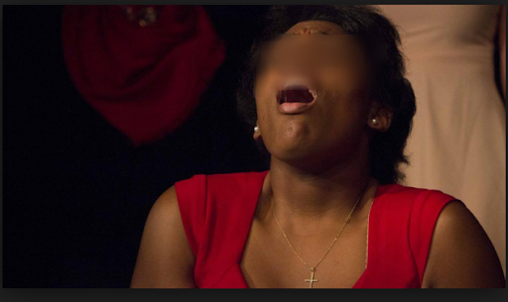
Persistent Genital Arousal Disorder (PGAD)
Experiencing chronic or even continuous sexual arousal:
  Unwanted and unrelated to sexual desire.
  Any release through orgasm is momentary.
Underlying causes are unknown.
No validated treatments exist.

Slide 39

Sexsomnia
A condition in which people engage in sexual behavior while they are asleep:
  Masturbation
  Partnered sex
  Dirty talking
  Vocalization
  May be quite forceful and harm a partner
Occurs as part of a sleep disorder known as parasomnia.

Slide 40
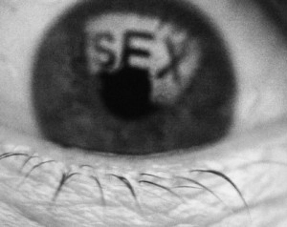
Hypersexual Disorder
Involves excessive and compulsive sexual behavior.
More common in men.
Consumes an excessive amount of time and interferes with other activities.
Creates dysfunction in work, school, or interpersonal relationships.
Associated with high risk sexual behaviors.
Absence of neuroscience research
Abundant anecdotal evidence but no physiological basis for sexual addiction.
Therapy modeled on 12-step programs for substance abuse is suggested.
May be called “sex addiction.”

